Slide 1
Energy Production
Team members:
Ms. Dr Hari Devi Bandari
Mr. Priyanshu Chauhan
Ms. Ankita Nilesh Nyati
Mr. Kamataala Pavan Kumar
Mr. Panchakshari Chandrayya Lesayyanavaramath
Mentor: Dilawar Basha/Rohit

Slide 2
Business Objective:
A combined-cycle power plant comprises gas turbines, steam turbines, and heat recovery steam generators. In this type of plant, the electricity is generated by gas and steam turbines combined in one cycle. Then, it is transferred from one turbine to another. We have to model the energy generated as a function of exhaust vacuum and ambient variables and use that model to improve the plant's performance.

Slide 3
Project Workflow:
Importing the Packages
Reading the Dataset
EDA(Exploratory Data Analysis)
Visualization
Final Dataset after EDA
Detecting Collinearity
Model Building
Final Model
Deployment

Slide 4
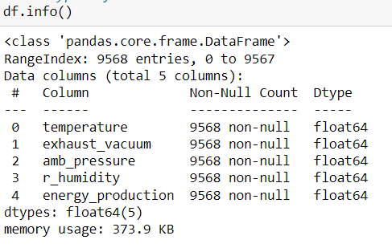
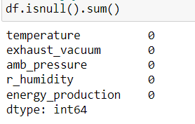
Data Set details:
The data set contains no null values.
There are 9568 rows and 5 columns.
The given five columns are float type.
There are no NULL Values in the dataset.

Slide 5
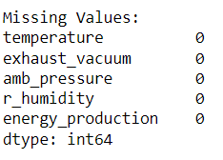
Missing Values Check:
There is no missing values is data set.

Slide 6
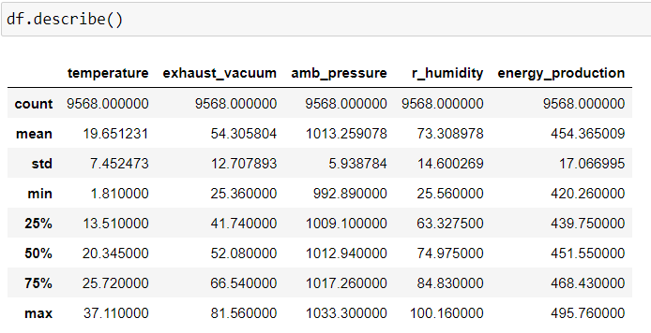
Data Description:
Here we found the count, mean, std, min, max of each column using df.describe() function.

Slide 7
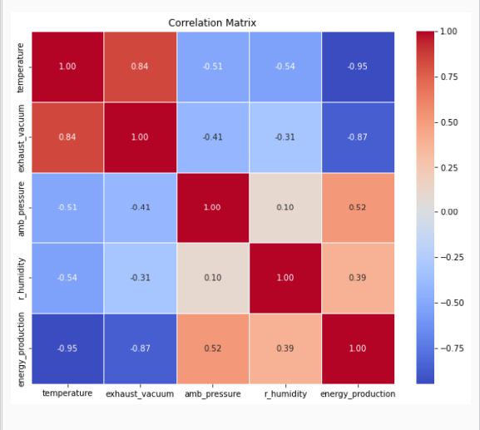
Correlation Heatmap:

Slide 8
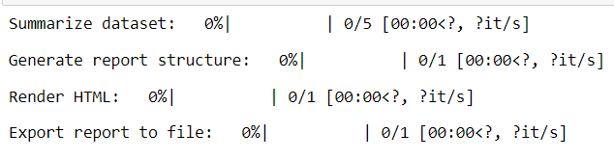
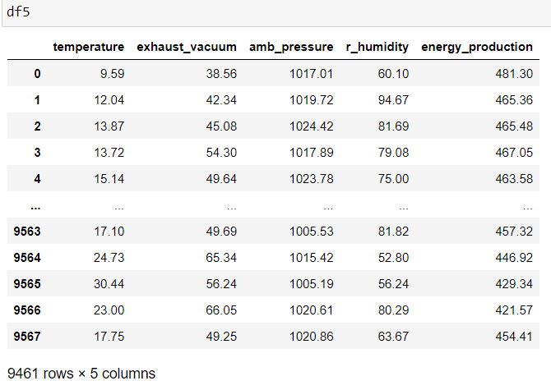
Final Dataset after EDA:
Final results after EDA.
There is no changes in EDA.

Slide 9
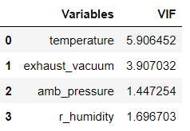
Cross-check with VIF :
Inference: There is no Mulit-collinearity between the variables , Since VIF is less then 20.

Slide 10
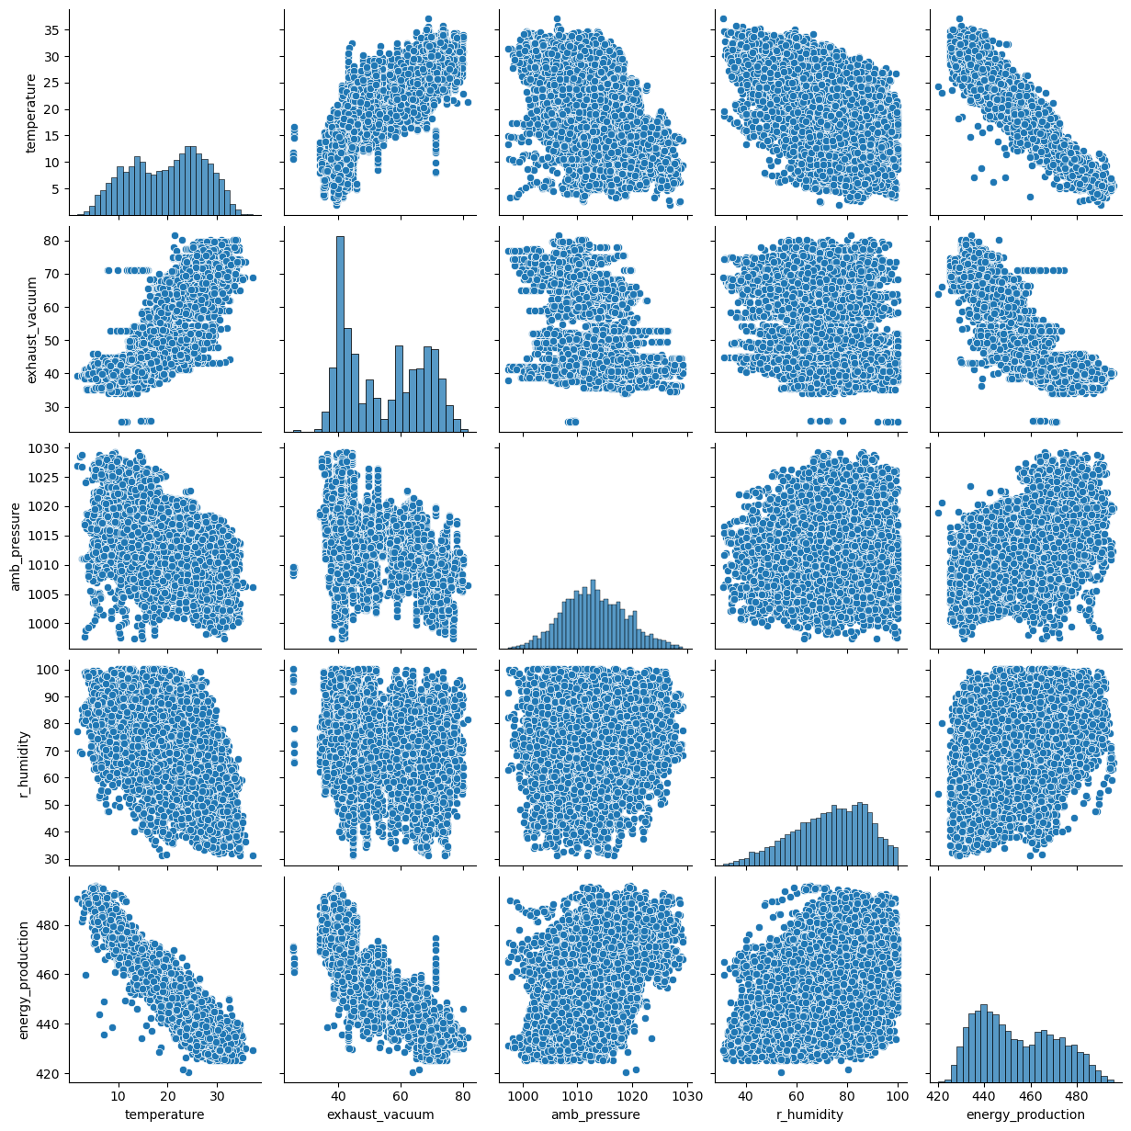
Explore relationships between features:
Pairplot

Slide 11
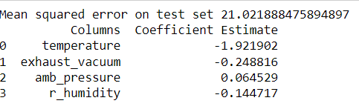
Model Building :
Model Validation :
Lasso and Ridge Regression
Out of the four variables there, three are negative(temperatue, exhaust_vacuum and r_humidity) and the remaining one is positive.(amb_pressure)

Slide 12
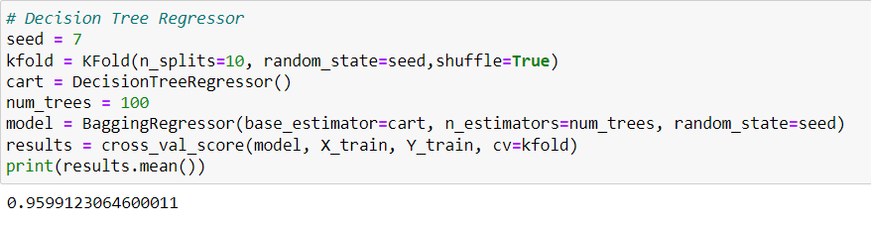
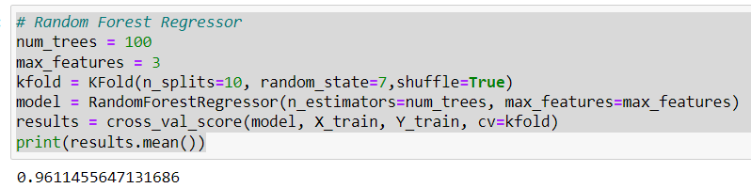
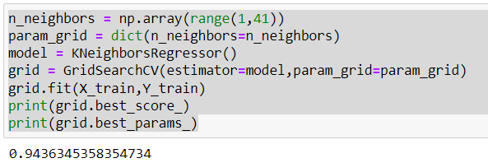
Ensemble Techniques :
Decision Tree Regressor
Random Forest Regressor
KNN Regressor
When ensemble techniques are applied to these four regressors (Decision Tree, Random Forest, Adaboost and KNN), the best results are given to Random Forest Regressor (Output : 0.9611).
As seen in the ensemble techniques, the random forest regressor gave the best results.

Slide 13
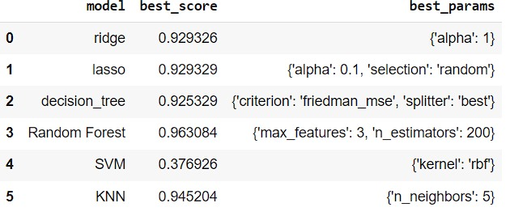
Based on hyperparameter tuning, Random Forest is anticipated to achieve the highest accuracy (best mean cross-validated score: ~0.963), outperforming Ridge Regression, Lasso Regression, Decision Tree, SVM, and KNN models.
ML Models on Dataset :

Slide 14
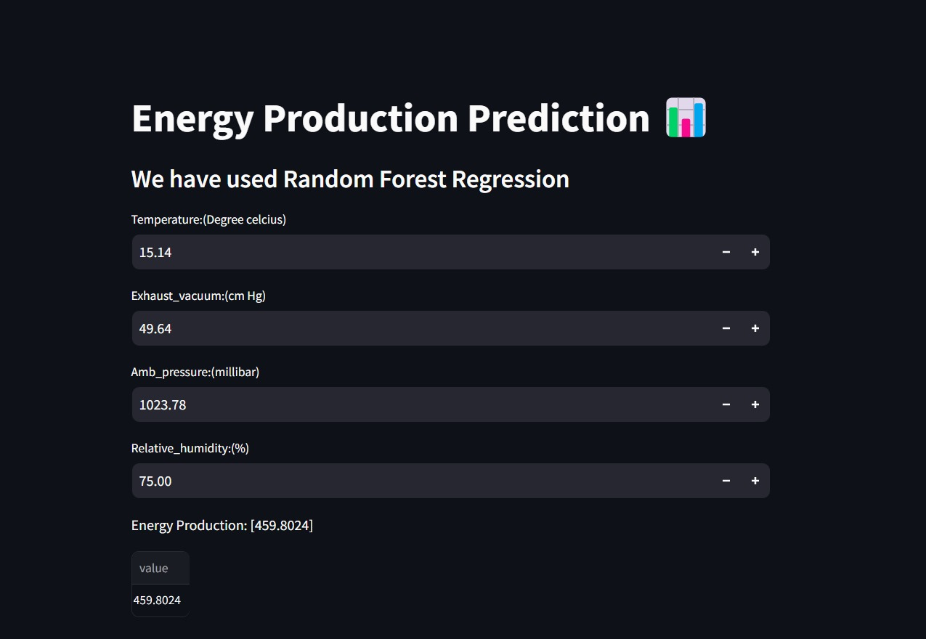
Deployment
We finalized our model based on highest accuracy that was near to 100 percent from random forest classifier.
We used streamlit to deploy our model.

Slide 15
Challenges :
Ensure the dataset is properly preprocessed, including handling missing values and encoding categorical variables, to prevent errors and ensure compatibility with the chosen regression algorithms.

Slide 16
Thank you

